Slide 1
Introduction to Preferential Ridings Proportional with Second- choice Vote Electoral System - PRP2 developed with the feedback of many interested Yukoners
for Yukon Citizens Assembly on Electoral Reform

Slide 3
Overall Goals of System
Second-choice votes make it possible for all voters to be able to discuss their concerns with an MLA that their vote elected, leading to more democratic engagement of constituents.
Simple system to vote and implement
Ballot allows voters more choice in candidates plus party choice
Paired-ridings avoid additional seats: one riding seat plus one proportional seat.
Eg. Riverdale North and Riverdale South become one Riverdale riding seat plus one proportional seat for Whitehorse.

Slide 4
Paired Ridings Grouped Into Electoral Areas
Each Riding has one Geographical MLA elected from preferential ballot using points from first and second choices on ballots.
  Point System described later
Ridings grouped into 3 electoral areas or regions for proportional MLAs:
  Whitehorse (10MLAs)
  Yukon West and North (5MLAs)
  Yukon South Centre and East (4MLAs)
MLAs for Proportional Party Seats are elected based on highest percentage of points in their riding (but did not win the riding seat).

Slide 5
Whitehorse ElectoralArea
5 Paired Riding Seats PLUS 5 Proportional Seats
  Riverdale South and Riverdale North
  Copperbelt North and Whitehorse West
  Porter Creek North and Porter Creek Centre
  Porter Creek South and Takhini – Copper King
  Whitehorse Centre and Mountain View

Slide 6
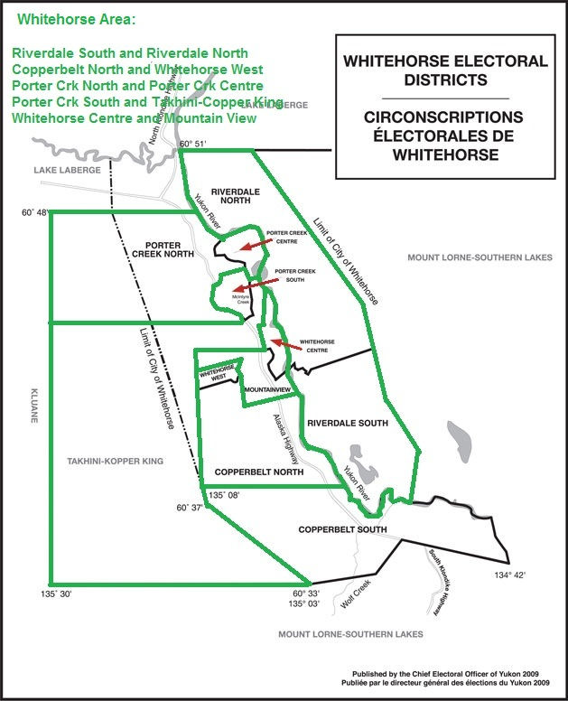

Slide 7
South Centre and East Yukon Electoral Area
2 Paired Riding Seats PLUS 2 Proportional Seats
  Mount Lorne – Southern Lakes and Copperbelt South
  Pelly – Nisutlin and Watson Lake

Slide 8
West and North Yukon Area
2 Paired Riding Seats PLUS 2 Proportional Seats PLUS Vuntut Gwitchin as an Individual Riding
  Kluane and Lake Laberge
  Klondike and Mayo-Tatchun
  Party Votes from Vuntut Gwitchin for Proportional Seats of this Area
  Non-winning Old Crow candidates are not eligible as a Proportional Candidate

Slide 9
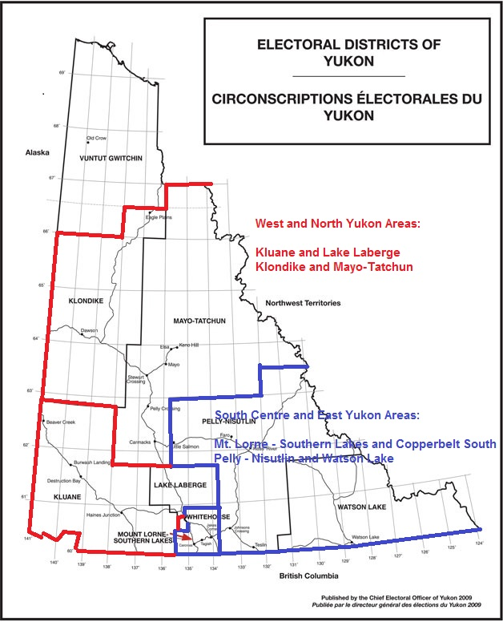

Slide 10
Point System to Elect Paired-riding MLAs
2 Examples:
  5 Candidates Running in a Riding
    First Choice Vote provides 4 Points
    Second Choice Vote provides 3 Points
  8 Candidates Running in a Riding
    First Choice Vote provides 7 Points
    Second Choice Vote provides 6 Points
Candidate with the highest number of points in each riding is elected
  Candidate with lower number of First-choice votes can win the seat from second choice vote points
  NOTE: Effectiveness of MLAs elected by FPTP, and overall governance, are greatly affected by the voters who did not vote for the MLA. Whether second-choice or last-choice has an effect.

Slide 11
Election of Proportional Candidates
Overall Party Preference Based on Percentage of Party Points totaled within each of the 3 Geographic areas
Each Party’s Proportional Seats are awarded to the Party’s Candidates that were not elected as a Riding MLA with the highest Percentage of Paired-riding Points

Slide 12
Preferential Ridings Proportional with second-choice vote PRP2 system
BALLOT
You have 3 votes
Mark one x under each Choice
CANDIDATE 1st 2nd PARTY Party
CHOICE CHOICE CHOICE
Candidate name Party A
Candidate name Party B
Candidate name X Party C
Candidate name X Party D X
Candidate name Independent

Slide 13
Effect of Boundaries Commission on PRP2
The PRP2 system will function effectively with boundaries changes.
The maximum size of electoral areas is ten MLAs. If there are more than ten MLAs in a region, two electoral areas will be formed.
In past FPTP elections, using present boundaries, the new system without second-choice votes, has taken vote representation in elections from less than 50% to more than 90%. Second-choice votes make 100% vote representation possible.

